Slide 1
SOCIOECONOMIC FACTORS ON INCOME
CIND 820-CAPSTONE PROJECT ANIL NATH

Slide 2
Understanding this project
Explore how socioeconomic factors effect ones income.
Create model to predict whether ones income is >50 or <=50k.
How Gender, Education level and hours worked per week affect this.
Using the UCI adult data set.

Slide 3
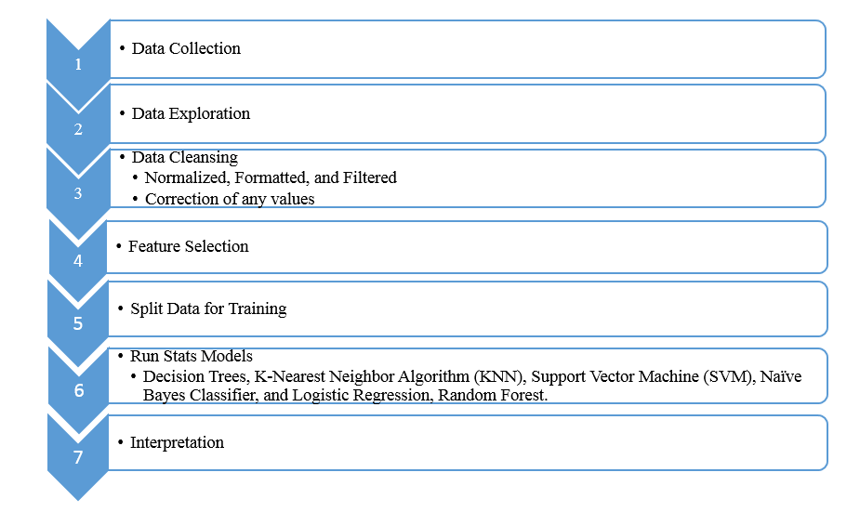
Project Approach

Slide 4
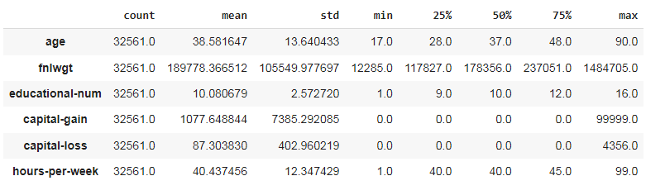
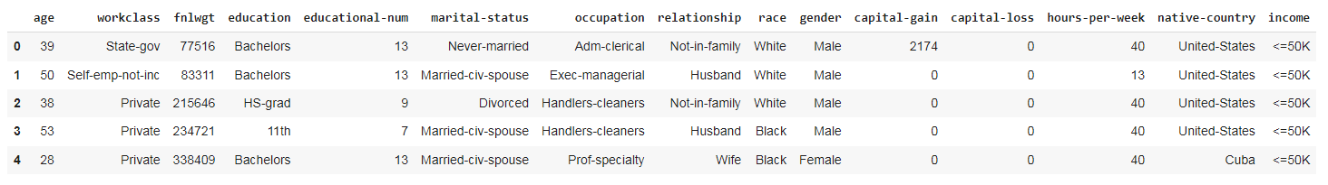
Data Description
Age: Describes the age of individuals. Continuous.
Workclass: Private, Self-emp-not-inc, Self-emp-inc, Federal-gov, Local-gov, State-gov, Without-pay, Never-worked.
fnlwgt: Continuous.
education: Bachelors, Some-college, 11th, HS-grad, Prof-school, Assoc-acdm, Assoc-voc, 9th, 7th-8th, 12th, Masters, 1st-4th, 10th, Doctorate, 5th-6th, Preschool.
education-num: Number of years spent in education. Continuous.
marital-status: Married-civ-spouse, Divorced, Never-married, Separated, Widowed, Married-spouse-absent, Married-AF-spouse.
occupation: Tech-support, Craft-repair, Other-service, Sales, Exec-managerial, Prof-specialty, Handlers-cleaners, Machine-op-inspect, Adm-clerical, Farming-fishing, Transport-moving, Priv-house-serv, Protective-serv, Armed-Forces.
relationship: Wife, Own-child, Husband, Not-in-family, Other-relative, Unmarried.
race: White, Asian-Pac-Islander, Amer-Indian-Eskimo, Other, Black.
sex: Female, Male.
capital-gain: Continuous.
capital-loss: Continuous.
hours-per-week: Continuous.
native-country:
salary: >50K,<=50K

Slide 5
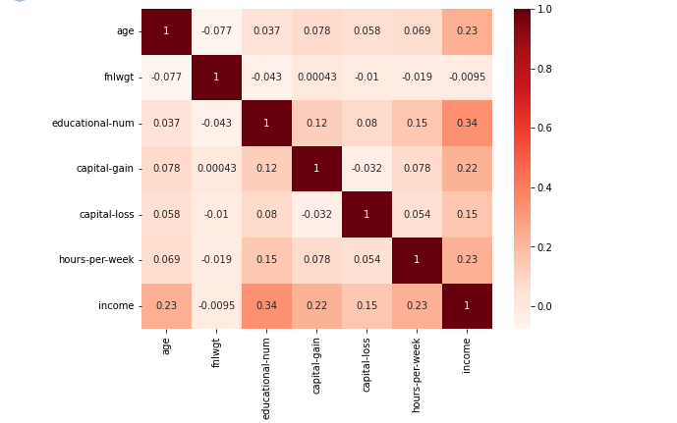
Exploratory Analysis
Ran a multitude of graphical analysis.
Found country biases.
Predictions on how males are more likely to make more money.

Slide 6
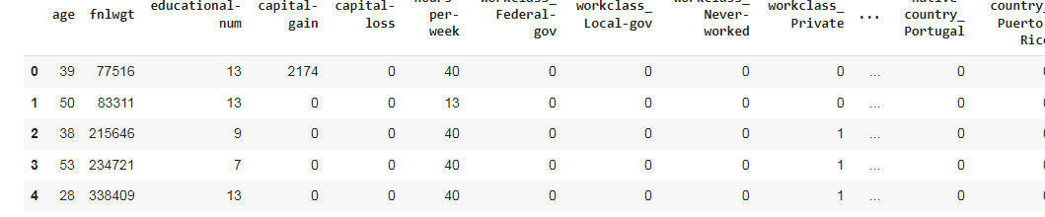
Data Preparation
As the model can take only Numerical features.
We transform all non-numerical features into numerical using One Hot Encoding (Dummy encoding)
Also Standardize numerical features.

Slide 7
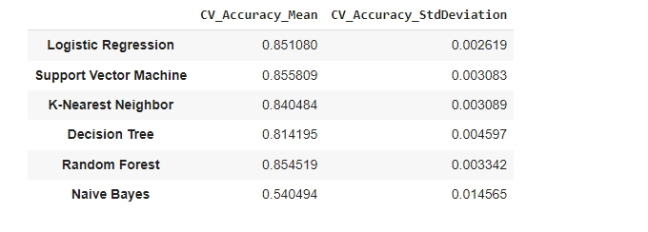
Models comparisons
Decision Trees,
K-Nearest Neighbor Algorithm (KNN)
Support Vector Machine (SVM)
Naïve Bayes Classifier
Logistic Regression
Random Forest
Use of K-cross Validation

Slide 8
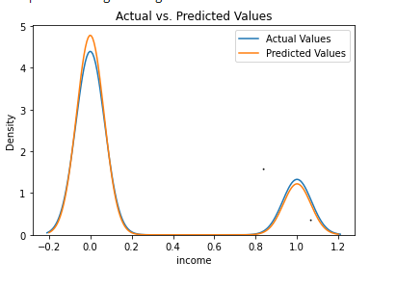
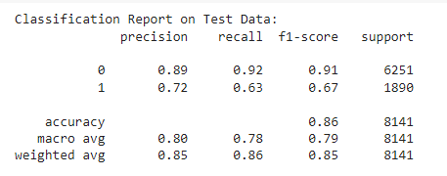
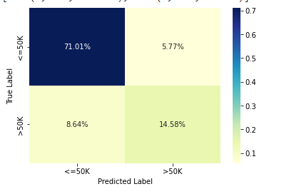
Random Forest
Random forests model ran very good.

Slide 9
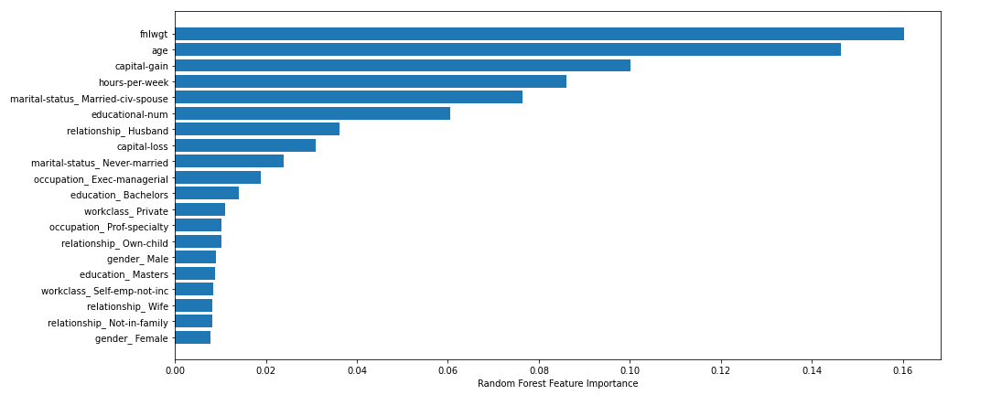
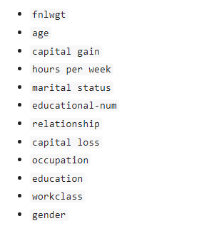
Factors Contributing to Prediction

Slide 10
Conclusion

Slide 11
Thank you for your time. Questions? https://github.com/Anil-nath/CIND820-Data-capstone-analysis

